Slide 1
Capstone Project
Bank Marketing Effectiveness Prediction

Slide 2
Content
Problem Statement
Data Summary
Data Analysis
Challenges
Conclusions
Q&A

Slide 3
Problem Statement
The data is related with direct marketing campaigns (phone calls) of a Portuguese banking institution. The marketing campaigns were based on phone calls. Often, more than one contact to the same client was required, in order to access if the product (bank term deposit) would be ('yes') or not ('no') subscribed. The classification goal is to predict if the client will subscribe a term deposit (variable y).

Slide 4
Data Summary
job : type of job (categorical: 'admin.' , 'blue-collar' , 'entrepreneur' , 'housemaid' , 'management' , 'retired' , 'self employed' , 'services' , 'student' , 'technician' , 'unemployed' , 'unknown')
marital : marital status (categorical: 'divorced' , 'married' , 'single')
education : (categorical: 'primary' , 'secondary' , 'tertiary' , 'unknown')
default: has credit in default? (categorical: 'no' , 'yes')
housing: has housing loan? (categorical: 'no' , 'yes')
loan: has personal loan? (categorical: 'no' , 'yes')
contact: contact communication type (categorical: 'cellular' , 'telephone' , 'unknown')
month: last contact month of year (categorical: 'jan' , 'feb' , 'mar', ..., 'nov', 'dec')
poutcome: outcome of the previous marketing campaign (categorical: 'failure' , 'success')

Slide 5
Contd ...
day : last contact day of year(categorical: 1 , 2 , . . . , 31)
age : (numeric)
duration: last contact duration, in seconds (numeric)
campaign: number of contacts performed during this campaign and for this client (numeric, includes last contact)
pdays: number of days that passed by after the client was last contacted from a previous campaign
previous: number of contacts performed before this campaign and for this client (numeric)
y - has the client subscribed a term deposit? (binary: 'yes','no')

Slide 6
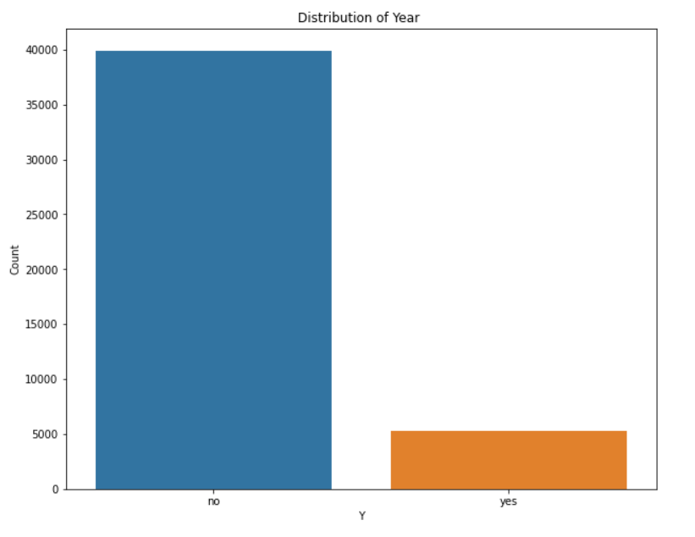
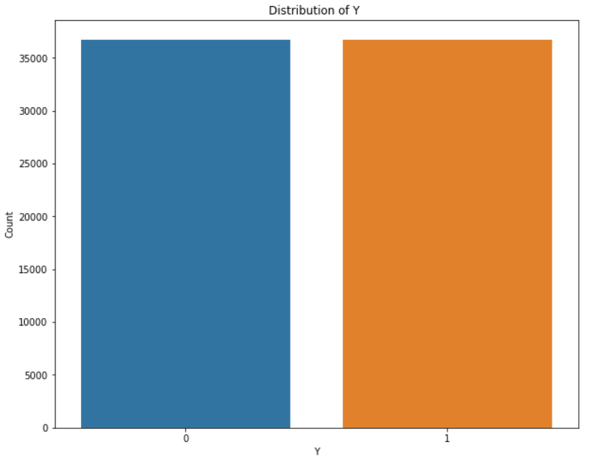
Count plot of Dependent Feature(Y)
Before After

Slide 7
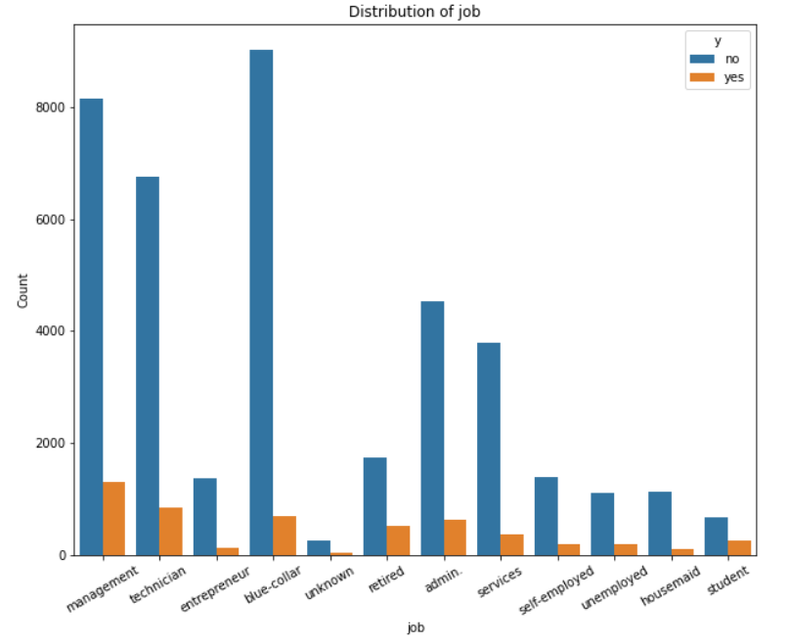
Count plot of Job

Slide 8
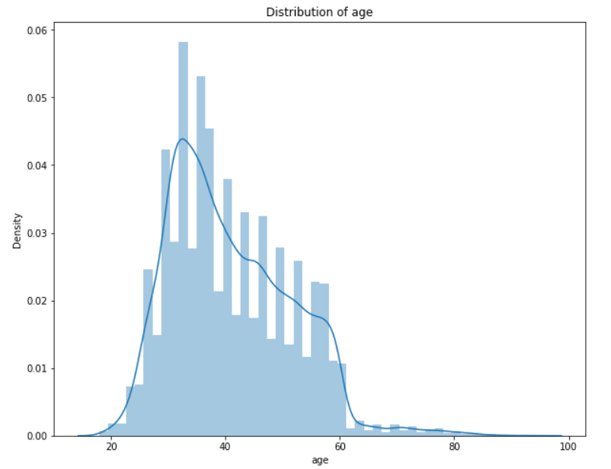
Distribution plot of Age

Slide 9
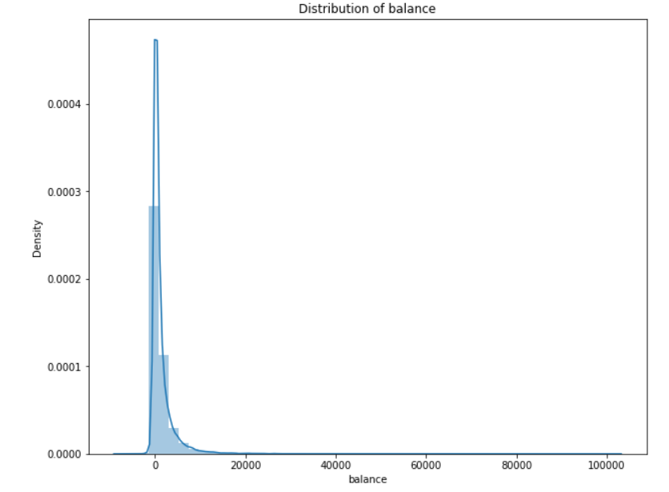
Distribution plot of Balance

Slide 10
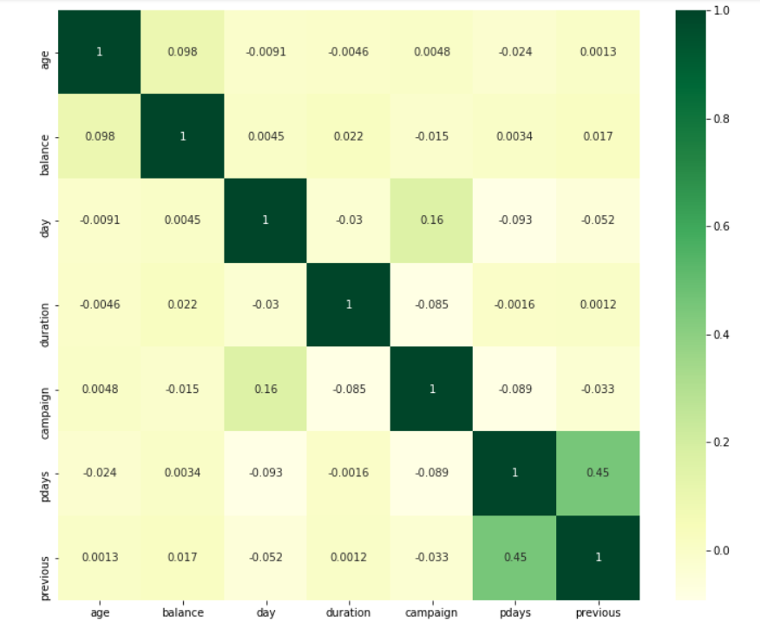
Correlation

Slide 11
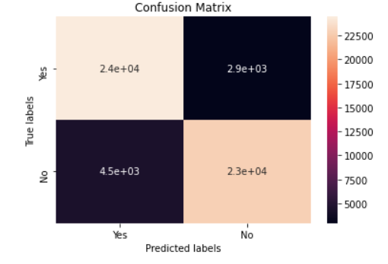
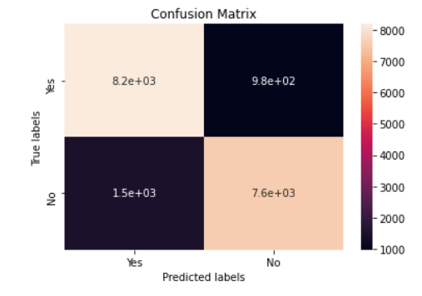
Logistic Regression
Best Parameters ROC-AUC score
C : 0.1
Confusion matrix of Train Data Confusion matrix of Test Data
Train Data | 0.93
Test Data | 0.93

Slide 12
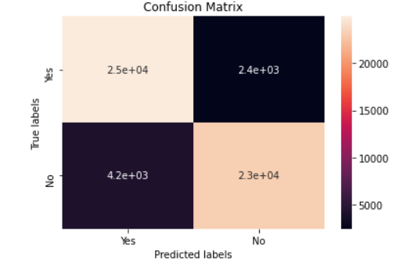
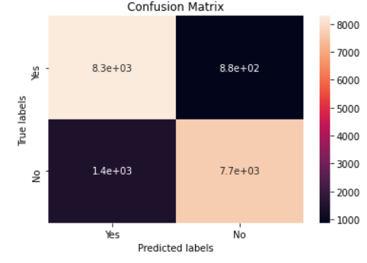
K-Nearest Neighbors
Best Parameters ROC-AUC score
n_neighbors : 27
Confusion matrix of Train Data Confusion matrix of Test Data
Train Data | 0.95
Test Data | 0.93

Slide 13
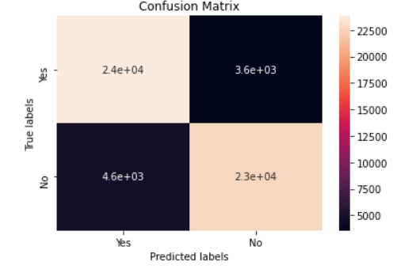
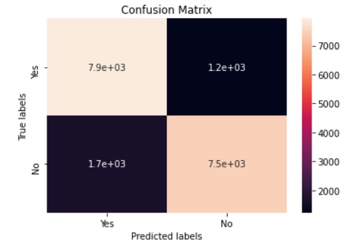
Decision Tree
Best Parameters ROC-AUC score
max_depth : 10
min_samples_leaf : 10
min_samples_split : 20
Confusion matrix of Train Data Confusion matrix of Test Data
Train Data | 0.95
Test Data | 0.93

Slide 14
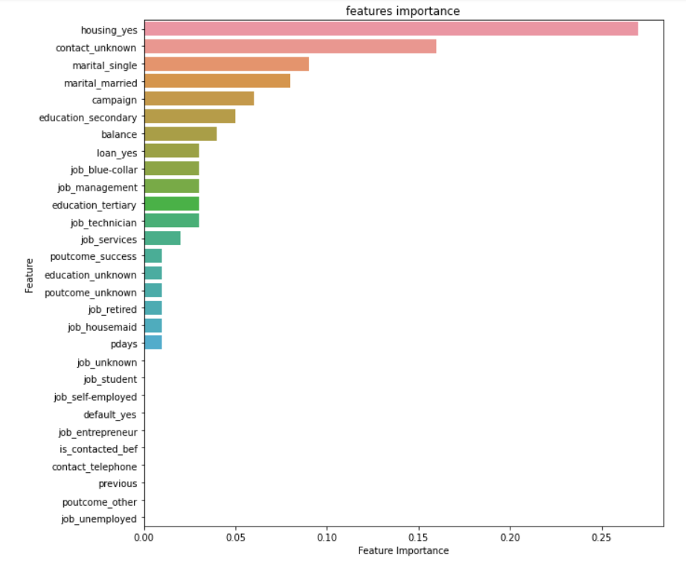
Decision Tree Feature Importance

Slide 15
RandomForest
Best Parameters ROC-AUC score
max_depth : 10
min_samples_leaf : 10
min_samples_split : 20
Confusion matrix of Train Data Confusion matrix of Test Data
Train Data | 0.92
Test Data | 0.92

Slide 16
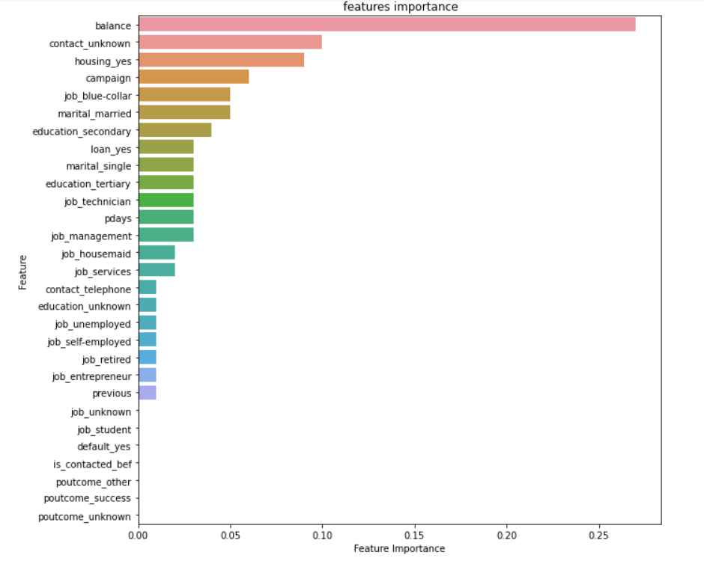
RandomForest Feature Importance

Slide 17
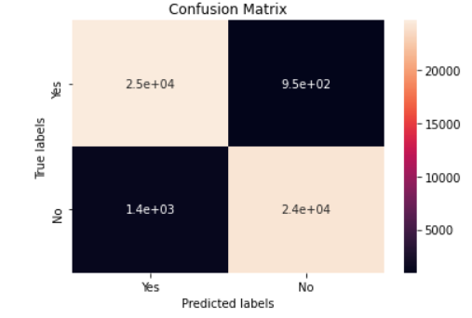
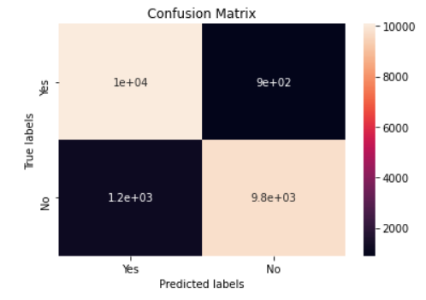
XGBoost
Best Parameters ROC-AUC score
learning_rate : 0.5
max_depth : 9
n_estimators : 125
Confusion matrix of Train Data Confusion matrix of Test Data
Train Data | 0.99
Test Data | 0.95

Slide 18
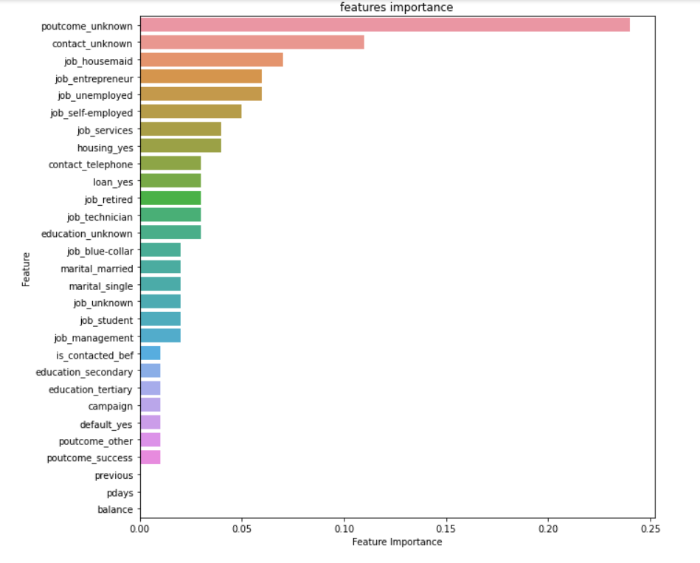
XGBoost Feature Importance

Slide 19
Challenges
Handling imbalanced datset
Feature Engineering
Optimising the Model

Slide 20
Conclusion
For age , most of the customers are in the age range of 30-40.
For balance , above 1000$ is like to subscribe a term deposite .
Comparing to all algorithms XGboost algorithm has best accuracy score and ROC-AUC score . So it is concluded as optimal model.

Slide 21
Q & A

Slide 22
Thank You

